Slide 1
Chapter 11: Trigonometric Identities and Equations
11.1 Trigonometric Identities
11.2 Addition and Subtraction Formulas
11.3 Double-Angle, Half-Angle, and Product-Sum Formulas
11.4 Inverse Trigonometric Functions
11.5 Trigonometric Equations

Slide 2
11.5 Trigonometric Equations
Solving a Trigonometric Equation by Linear Methods
Example Solve 2 sin x – 1 = 0 over the interval [0, 2π).
Analytic Solution Since this equation involves the first power
of sin x, it is linear in sin x.
Two x values that satisfy sin x = ½ for are
However, if we do not restrict the domain there will be an infinite amount of answers since:
for k any integer.

Slide 3
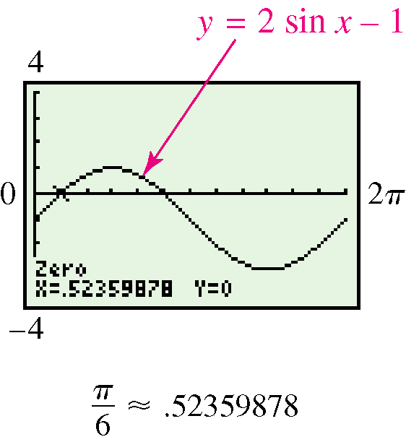
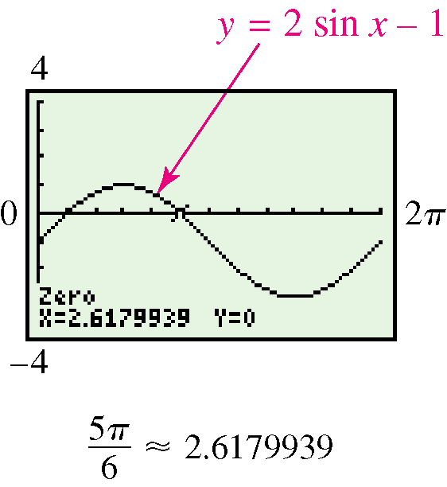
11.5 Solving a Trigonometric Equation by Linear Methods
Graphing Calculator Solution
Graph y = 2 sin x – 1 over the interval [0, 2π].
The x-intercepts have the same decimal
approximations as

Slide 4
11.5 Equations Solvable by Factoring
Example Solve 2sin² x – sin x – 1 = 0
Solution This equation is of quadratic form so:
The solutions for sin x = - ½ in [0, 2π) are x =
The solutions for sin x = 1 in [0, 2π) is x =
Thus the solutions are:

Slide 5
11.5 Solving a Trigonometric Equation by Factoring
Example Solve sin x tan x = sin x.
Solution
Caution Avoid dividing both sides by sin x. The two solutions that make sin x = 0 would not appear.

Slide 6
11.5 Solving a Trigonometric Equation by Squaring and Trigonometric Substitution
Example
Solve over the interval [0, 2π).
Solution
Square both sides and use the identity 1 + tan² x = sec² x.
Possible solutions are:
Or are they? Check answers!

Slide 7
11.5 Trigonometric Equations
Solving an Equation Using a Double-Number Identity
Example Solve cos 2x = cos x over the interval [0, 2π).
Analytic Solution
Solving each equation yields the solution set

Slide 8
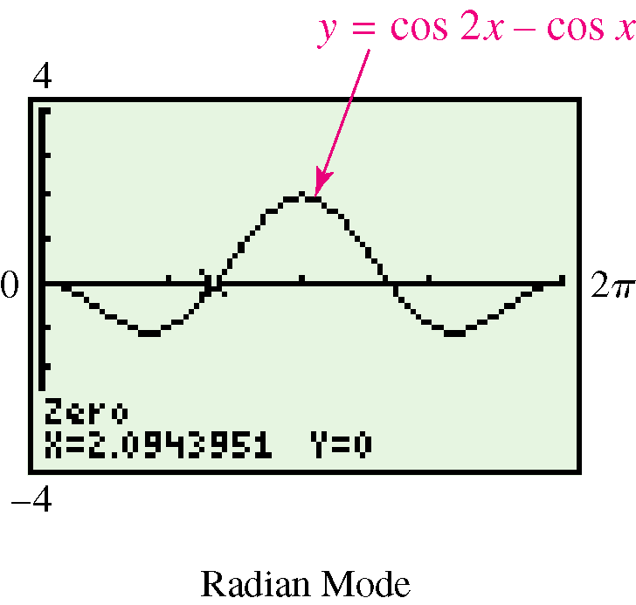
11.5 Solving an Equation Using a Double- Number Identity
Graphical Solution Graph y = cos 2x – cos x in an appropriate window, and find the x-intercepts.
The x-intercept displayed is 2.0943951, an approximation for 2π/3. The other two correspond to 0 and 4π/3.

Slide 9
11.5 Solving an Equation Using a Double-Number Identity
Example Solve 4 sin x cos x = over the interval [0, 2π).
Solution
From the given domain for x, 0 ≤ x < 2π, the domain for 2x is 0 ≤ 2x < 4π.
Since 2 sin x cos x = sin 2x.

Slide 10
11.5 Solving an Equation that Involves Squaring Both Sides
Example Solve tan 3x + sec 3x = 2
Solution Since the tangent and secant functions are
related by the identity 1 + tan² θ = sec² θ , we begin by
expressing everything in terms of secant.
Square both sides.
Replace tan² 3x with
sec² 3x – 1.

Slide 11
11.5 Solving an Equation that Involves Squaring Both Sides

